Slide 1
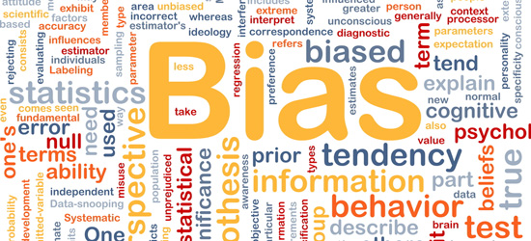

Slide 2
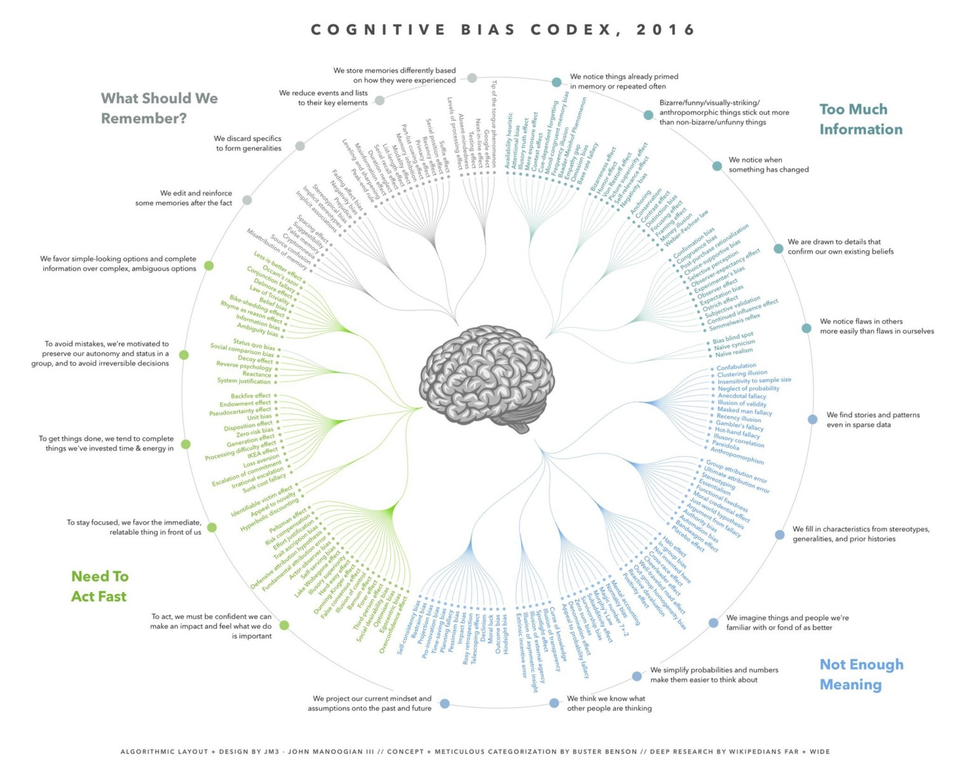

Slide 3
Cognitive Ease

Slide 4
Cognitive Ease
A measure of how hard your brain is working trying to process a situation.
It’s measured from “Easy” for when you are scrolling Facebook up and down to “Strained” for when you are solving 14 x 37.

Slide 5
Cognitive Strain
Is the opposite of Cognitive easy
Is the actual effort necessary to fully understand something
Requires a large amount of energy from the brain
Is associated with grumpiness or seriousness
Scientists tend be serious or suspicious of everything, which may be a requisite to develop a critical mind.

Slide 6
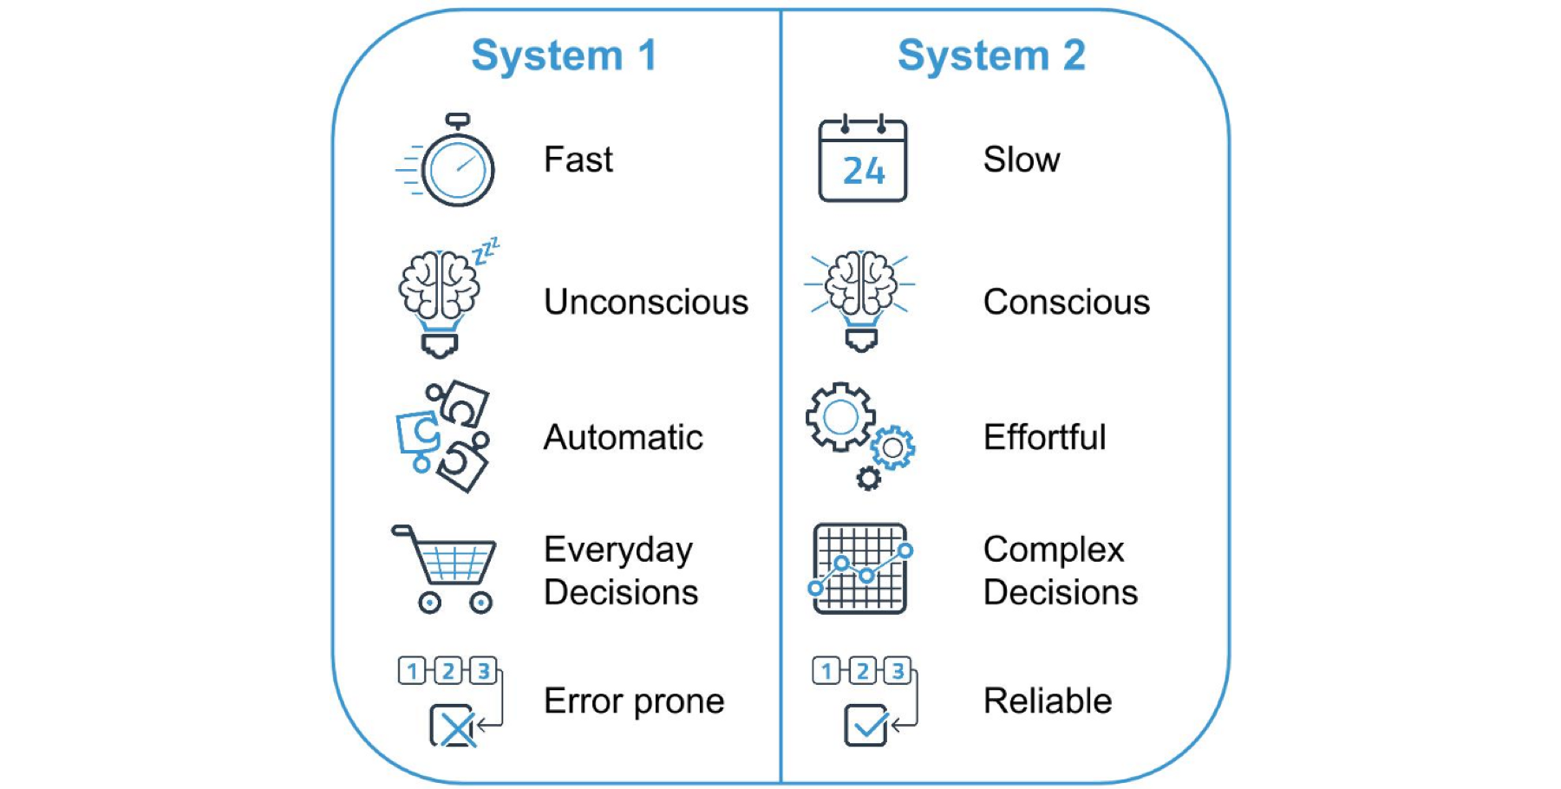
- We have two primary systems for thinking: System 1 operates quickly with no sense of voluntary control. System 2 deals with effortful mental activity of any kind.

Slide 7
Cognitive ease in action
All rose are flowers
Some flowers fade quickly
Some roses fade quickly
Do you agree?

Slide 8
ALL Flowers
Fade quickly
Roses

Slide 9
Cognitive ease
Makes you happy. It takes way the processing that your brain has to do otherwise.
It feels good because it is something recognizable.
It is less energy costly, no special calculation or ponderation.

Slide 10
Cognitive ease
Makes you accept more easily reality without having to engage in heavy mental calculations all the time. It helps us navigate the world
On the other hand makes us less critic. In areas of knowledge where ideas are counterintuitive it lead us to make wrong assumptions.

Slide 11
When we should use and when we should avoid cognitive ease?
In a ‘share all’ society what are the implications of cognitive ease?
Is there space to cognitive ease in a scientific environment?

Slide 12
Learning from Patterns

Slide 13
Three Magic Numbers
Can you find the rule behind the sequence?
2,4,8
Notes:
Base on https://www.youtube.com/watch?v=vKA4w2O61Xo&index=38&list=WL&t=0s

Slide 14
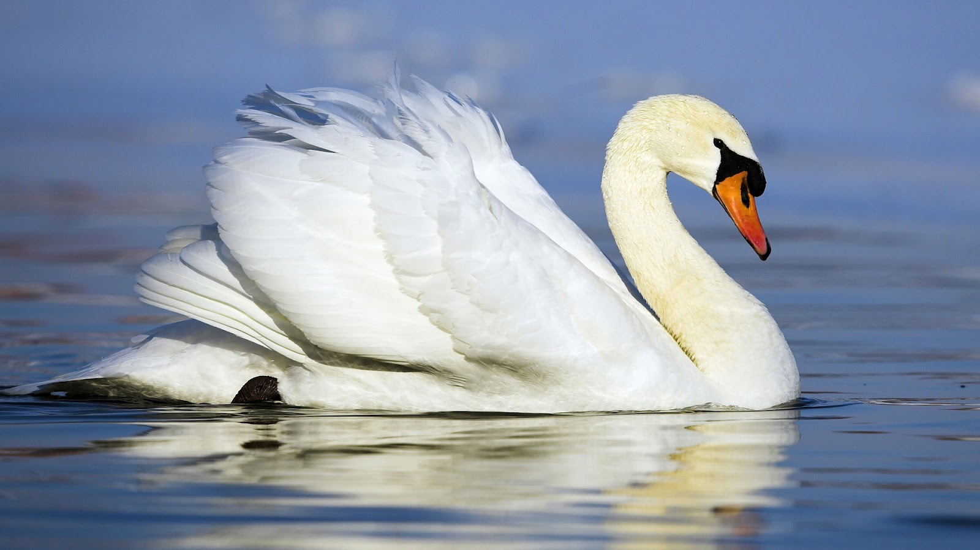
In the old world there was a theory that all swans were white.

Slide 15
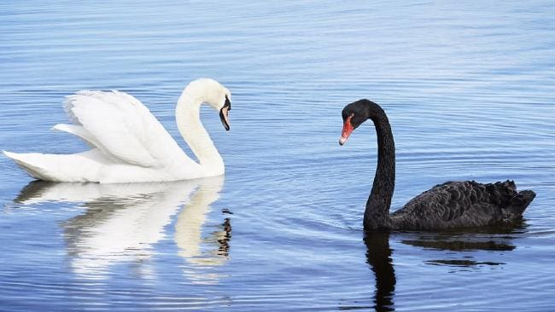
The Black Swan by Nassim Taleb
Until they get to Australia and found out that Black swans exists.
What does this tell us about the Scientific method?

Slide 16
Science is about trying to prove a hypothesis by the means of predictions that confirms it, but more importantly by failing to find proofs that contradict it.

Slide 17
The Illusion of Truth
Notes:
https://www.youtube.com/watch?v=nVRco_eLjdc (Why we are wrong when we think we are right . on misjudging someone based on his/her appearance. ) Who is annoyed by someone always trying to be right?

Slide 18
Truth can be fabricated!!!
Repeat until true
People exposed to the phrase “The body temperature of a chicken”, were more likely to accept the statement “The body temperature of a chicken is 39 C”
Thinking, Fast and Slow. Daniel Kahneman
Notes:
based on https://www.youtube.com/watch?v=cebFWOlx848&index=29&list=WL&t=0s

Slide 19
Repeating something over and over again
- Michigan experiment with word frequency
Meaningless words that appeared in a newspaper were associated with a positive meaning as opposed to rare meaningless words.

Slide 20
Creating Truth
Celebrity and show business
Participants of studies about facial data, judged faces that they saw repeated more time as being more friendly.
The Kardashians effect
Music that is played more often in radios tend to be more liked.
“… good publicity is preferable to bad, but from a bottom-line perspective, bad publicity is sometimes better than no publicity at all. Controversy, in short, sells. — Donald J. Trump, The Art of The Deal, 1987”

Slide 21
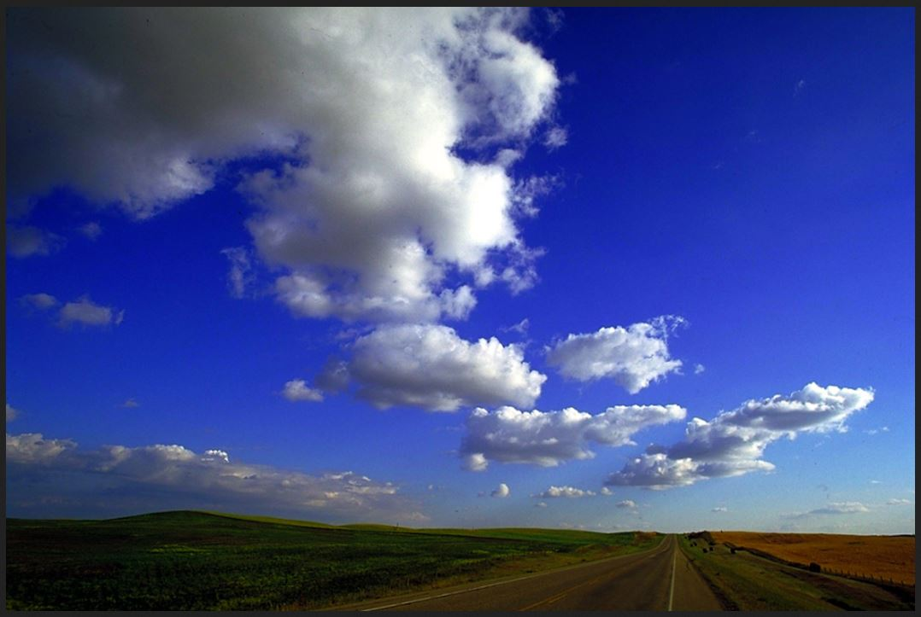
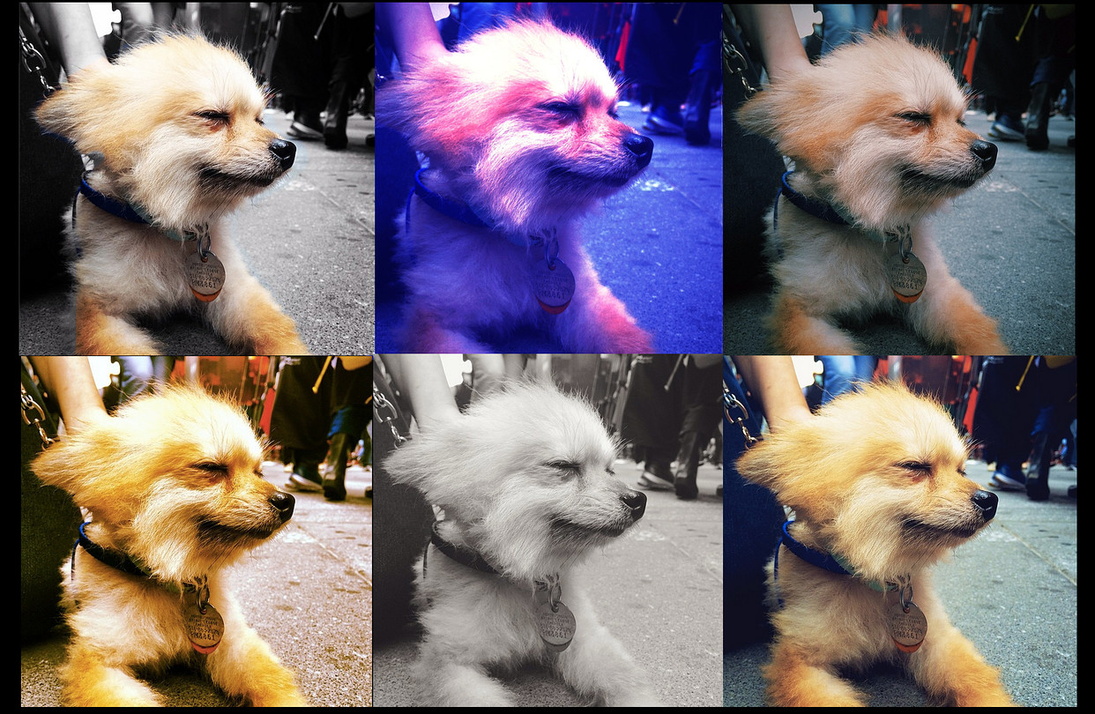
Images
Photos with high contrast or outlines are perceived as more positive.
That is why Instagram has so many filters.

Slide 22
Text
Easy to read is better than hard
Which statement you believe to be true?
Einstein was born on 1887
Einstein was born on 1884
Lawyers with easier to read names have more clients (even when the study controls for ethnicity)
Companies with easier Symbols ABC GOO, sells more share on the stock market then hard to read shares WYKV, XVGY
Notes:
1879

Slide 23
Confirmation Bias
Notes:
https://www.youtube.com/watch?v=nVRco_eLjdc (Why we are wrong when we think we are right . on misjudging someone based on his/her appearance. ) Who is annoyed by someone always trying to be right?

Slide 24
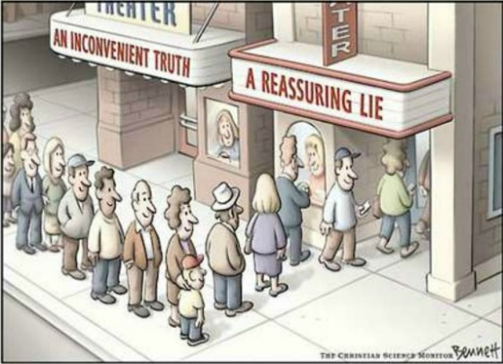
Confirmation bias
Confirmation bias is the tendency to search for, interpret, favor, and recall information in a way that confirms one's preexisting beliefs or hypotheses

Slide 25
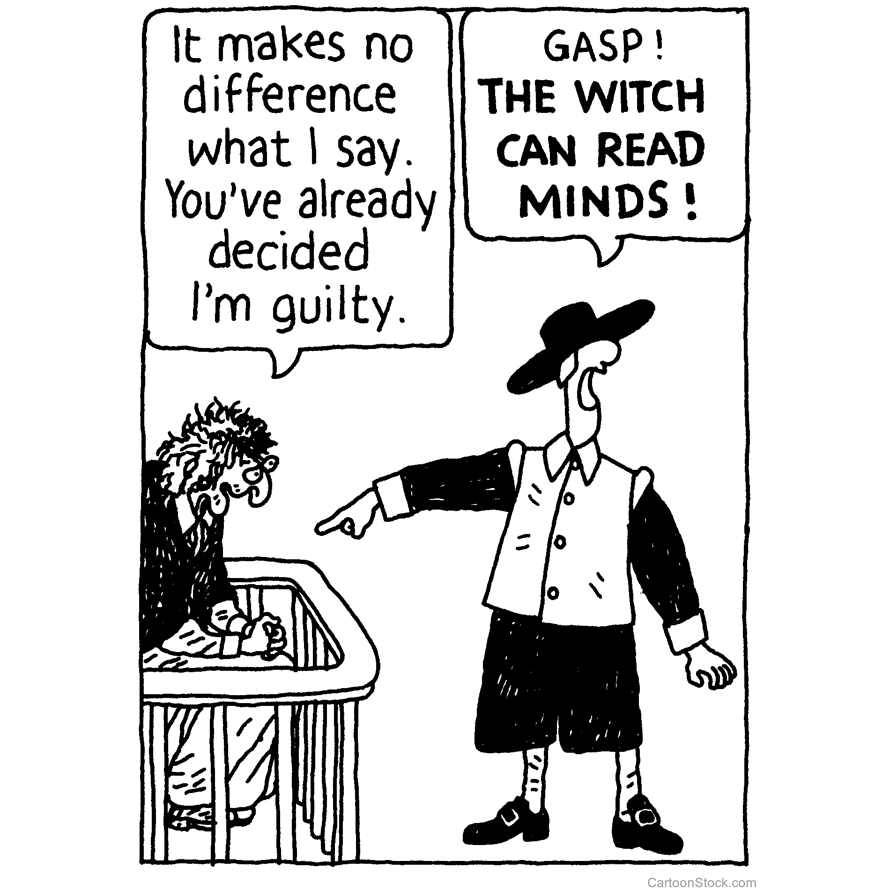
We use confirmation bias when we draw conclusions based on our own set of values, while ignoring facts that disprove our points.

Slide 26
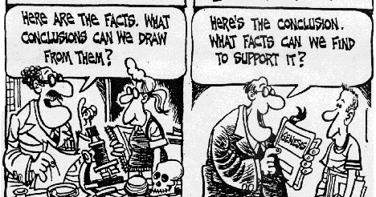
Confirmation Bias appears in many ways.
- A person with a point of view X is more likely to ‘google’ what are the benefits of X, when she/he is trying to prove that X is better than Y.

Slide 27
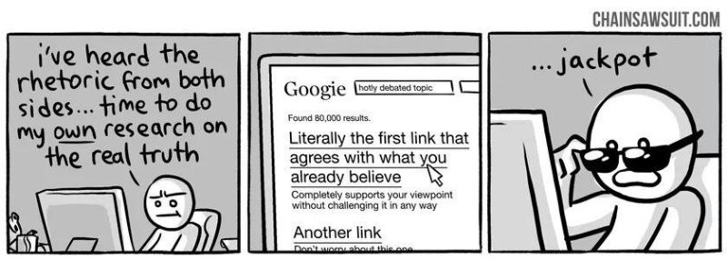
For example someone trying to prove the benefits of praying in the outcome of a situation is more likely to search ‘what are the benefits of praying?’
However the proper way to answer this question would be ‘Is there any difference in outcome between groups that pray and do not pray?’

Slide 28
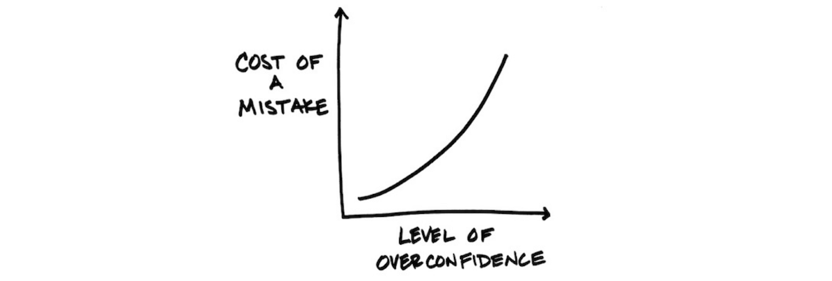
Confirmation Bias leads to overconfidence and big mistakes. There is no global warming, I am sure about it!

Slide 29
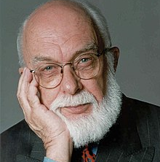
James Rand’s Astrology Experiment
A Canadian-American retired stage magician and a scientific skeptic who has extensively challenged paranormal and pseudoscientific claims.
Notes:
Dan Heath: We’ve assembled a group of people for a little experiment, with a nod to James Randy, also known as the Amazing Randy. He’s a famous magician, and he did the original experiment back in the 1990s.
First, we had an astrologer interview these people individually.
Heather: Have you ever had an astrology reading before? Do you follow horoscopes?
Alice: I have not had an astrology reading, and I occasionally read horoscopes.
Heather: Occasionally read horoscopes.
Dan Heath: From those interviews, she has prepared some customized readings.
Heather: Now I’m gonna ask you a series of questions, and they’re just agree or disagree questions, so you can go agree or disagree.
Participants: OK.
Heather: OK. You often get so lost in thoughts that you ignore or forget your surroundings.
Participants: Agree.
Dan Heath: Next, we gathered all the people that she interviewed into the same room. Then our astrologer handed out those customized readings.
Heather: OK, Alice, David, Tara …
Dan Heath: Just to give you a feel for this, one of the participants was named Alice, and she had about 12 different comments on her reading. The first one was, “You have a great need for other people to like and admire you.” Another comment was, “At times, you have serious doubts as to whether you have made the right decision or done the right thing.”
Alice and everyone else have a chance to review their personal readings, and then …
Heather: OK, so on a scale of one to five, one being the lowest, five being the highest, how do you feel that your personalized reading represents you? Is anyone a one?
Participants: No.
Heather: Two?
Participants: No.
Agree with her.
Heather: Three? And Four?
Participants: I’m a four.
Four, four and a half.
Yeah.
Heather: Four, four and a half.
Participants: Four point eight.
Heather: Four point eight.
Five?
Participants: I think I’m five alive.
Heather: You’re five alive?
Participants: I might actually be a five. I just didn’t want to admit that this is a five.
I think I’m a four.
Dan Heath: Almost everyone in the group agreed that the reading captured their personality. Score a victory for astrology. Here’s where things get interesting.
Heather: What I want you to do now is just to, and we’ll pass it this way. Pass your reading over to the person that is to the left of you and then read that person’s horoscope/reading.
Participants: Wait, what?
This was, I didn’t know this was part of the …
This is the exact same as mine.

Slide 30
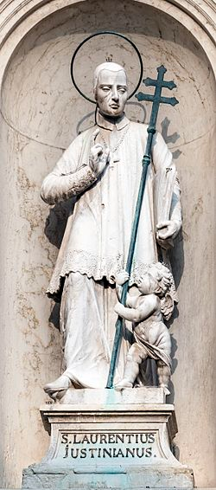
Pope Leo X
It’s the late 16th century, Pope Clement VII brought together several priests to start the secret process of canonization for the late Lawrence Justinian, a bishop from Venice.
The priests, they fully support sainthood for Justinian. He was a beloved figure, a man who was born into nobility but gave up a life of wealth and privilege to serve the church, but there’s an obstacle to sainthood

Slide 31
Pope Clement’s predecessor, Leo X, didn’t want this process to be hasty, he didn’t want it to be automatic, becoming a saint should be a big deal after all.
He assigned a priest to argue against every candidate for sainthood. That priest would dig into their background and try to poke holes in their candidacy.
That role came to be known as?

Slide 32
The devil’s advocate.
Before Lawrence Justinian can become a full-blown saint, he first has to get past the devil’s advocate.
Pope Leo X, had realized that confirmation bias would have played a big role in the decisions made about saints. He comes up with a solution, the devil’s advocate.

Slide 33
In the early days of the church
Saints were made by popular acclamation
There were thousands of these local saints listed because of the stories of the miracles they did and the extraordinary virtues that they had.
So, the church started a process where they would inquire into the lives of the candidates.

Slide 34
The devil’s advocate would try to poke holes in what was being presented.
That back and forth led to many fewer saints.
From 1000 AD to 1978 AD, fewer than 450 men and women were canonized.

Slide 35
The position of devil’s advocate was eventually discontinued, retired in the 1980s by Pope John Paul II.
What happened as a result?
Under the reign of just one pope, Pope John Paul II, over 480 saints were proclaimed.

Slide 36
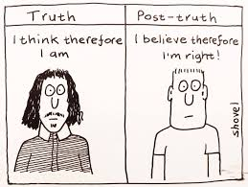
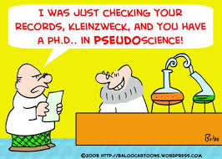
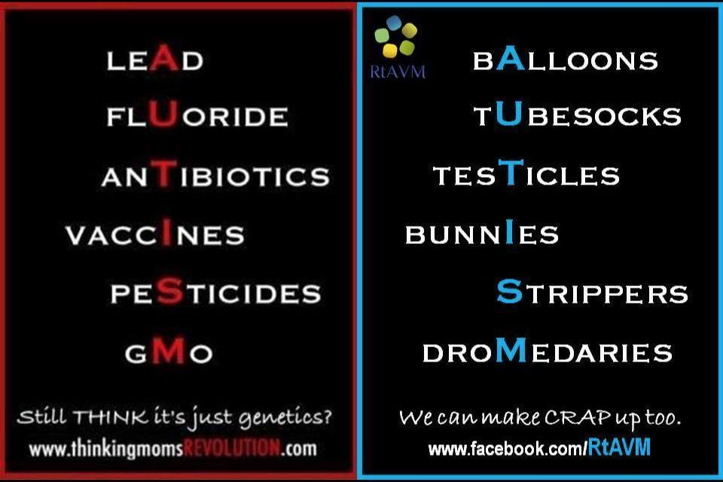
How are Truths fabricated in Science?

Slide 37
Endowment effect
Notes:
https://www.schwab.com/resource-center/insights/content/choiceology-season-2-episode-8

Slide 38
Endowment effect
The bias and perception that the personal ownership of an object exceeds any listed market value.

Slide 39
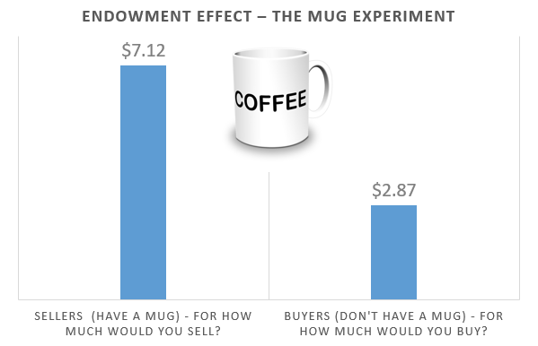
The Mug study
Results showed that the sellers (who owned the mugs) placed a significantly higher value on the mugs than the buyers did. They were willing to sell a mug for $7.12 while buyers were willing to pay $2.87 (median reservation prices).

Slide 40
Loss Aversion
Notes:
Drs fighting to disprove medical error. ccccckcccc

Slide 41
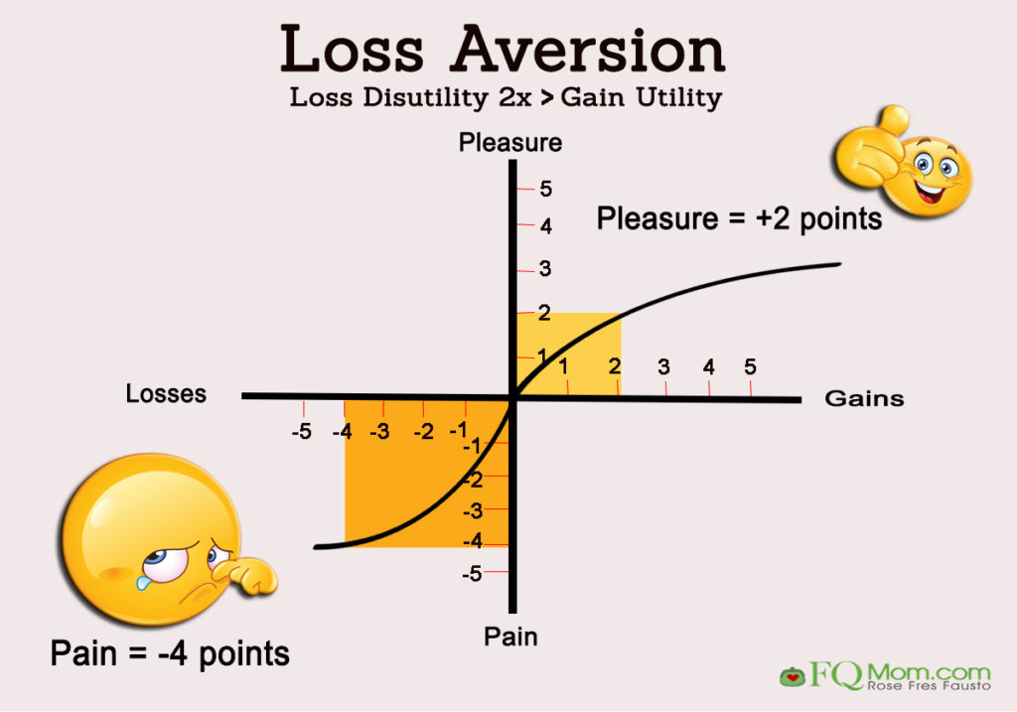
The Coffee Shop experiment
Which scenario is more likely to trigger a change in attitude?
1- Losing 1 dollar
2- Gaining 1 dollar

Slide 42
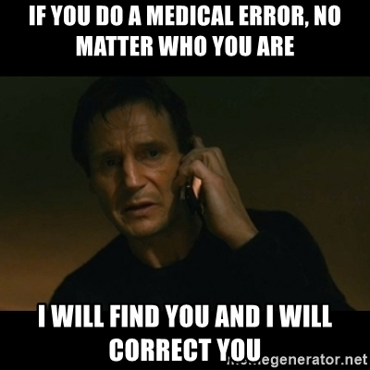
The Medical error case
Why spend 14 year and
+100.000 dollars to
prevent paying 15 000
in compensation and
releasing a public apology?

Slide 43
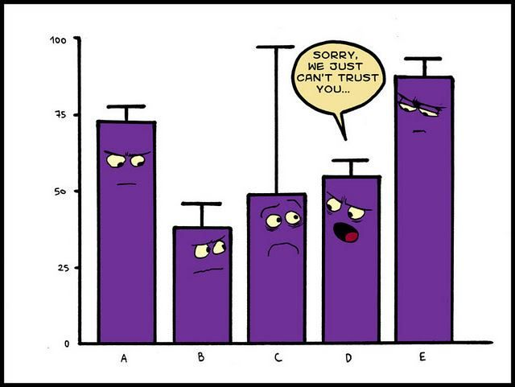
In science, what happens when we combine Endowment effect and Loss aversion?

Slide 44
Randomness

Slide 45
What is randomness?
Randomness is the lack of pattern or predictability in events.

Slide 46
The Head and Tail experiment
The Ipod problem
All possibilities are Equally Likely

Slide 47
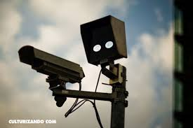
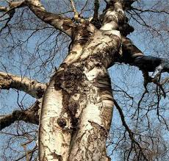
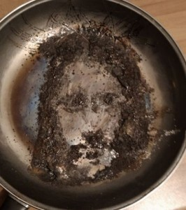
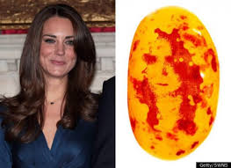
Pareidolia is the tendency to interpret a vague stimulus as something known to the observer, such as seeing shapes in clouds, seeing faces in inanimate objects or abstract patterns, or hearing hidden messages in music.

Slide 48
We can do things when we find order. Our job is to find the order in the world and take advantage of it, and so evolution has built this machinery to do just that.
One must be careful in order not to try forcefully find order and patterns in seemly random data.
We must avoid applying our own bias in our analysis.

Slide 49
Hindsight Bias
Notes:
https://www.schwab.com/resource-center/insights/content/choiceology-season-3-episode-4

Slide 50
Hindsight Bias
Also known as the knew-it-all-along phenomenon or creeping determinism, refers to the common tendency for people to perceive events that have already occurred as having been more predictable than they actually were before the events took place.

Slide 51
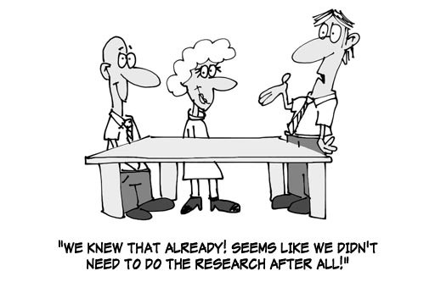
It changes how we perceive past events
- Drunk drive
We build a narrative and we selectively choose different details to make sense of the event now that we know about it.

Slide 52
Fighting Biases
Notes:
https://www.youtube.com/watch?v=nVRco_eLjdc

Slide 53
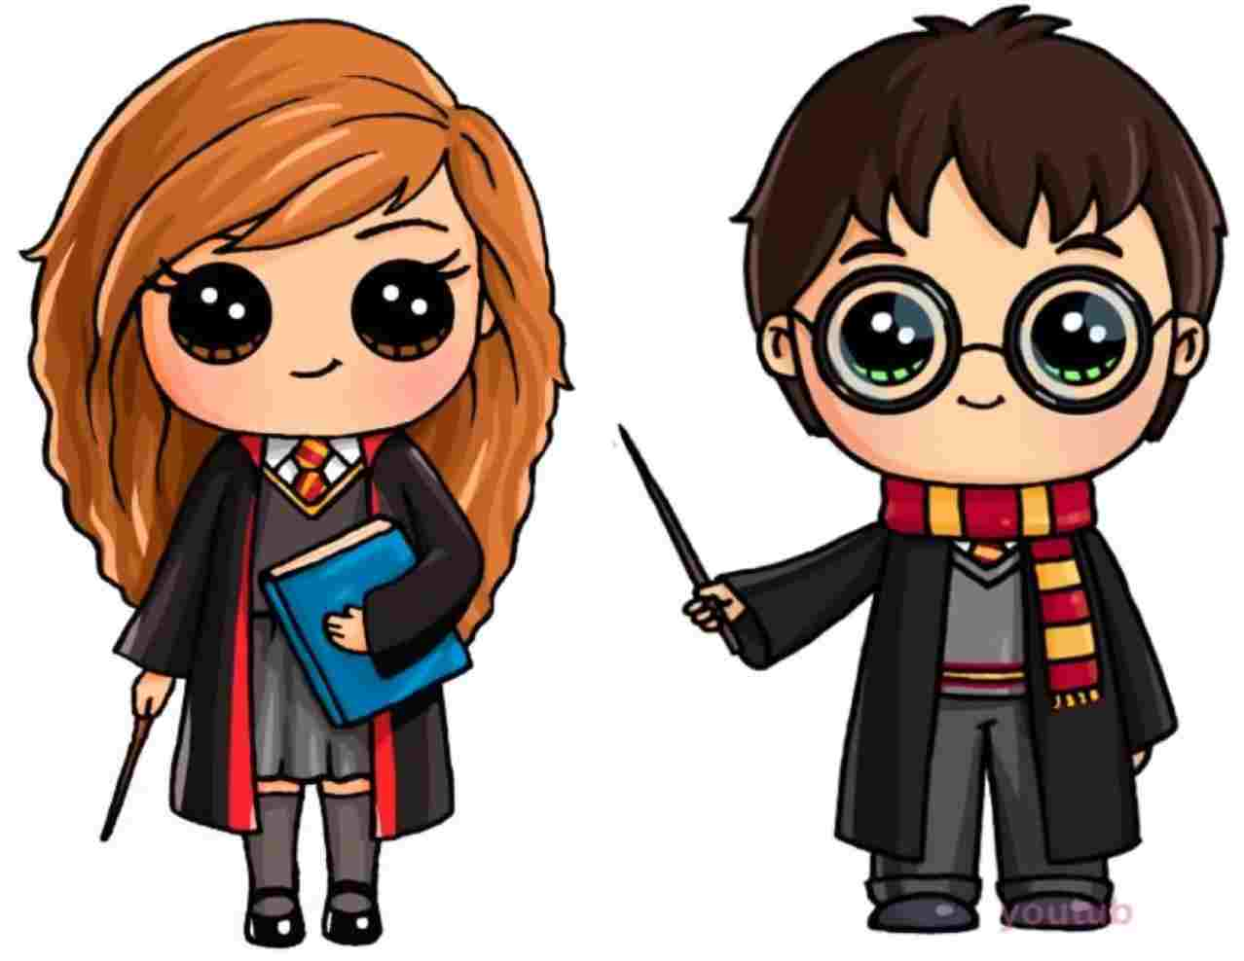
Meet Tetê, she has a story to tell us
Last week I met this guy, so beautiful, intelligent, romantic.
We have so much in common...

Slide 54
But Tetê there is nothing about him that is bad?
OH No!!! He is perfect!!!
Confirmation Bias. it is a systematic tendency that we actively seek only information that confirms our beliefs and we reject information that disconfirms

Slide 55
A couple of months later...
Ahhh!!! He is so stubborn, he never listens to me.
When I tell this to him, he says I do the same!!!

Slide 56
But you all know, I am a very good person. I am the good one in this relationship....
Self-Serving Bias. A tendency where we focus our attention only to that information that enhances our self-esteem and protects us from any negative feedback.

Slide 57
A couple of months later...
Ahhh!!! He is so terrible, a horrible person
I had to terminate this relationship.

Slide 58
It was clear from the beginning that this was going to happen...
I saw it all coming...
Hindsight Bias. A tendency that we don't remember the past according to what we experienced but to what happened.

Slide 59
What we learn from Tetê?
Confirmation Bias: Confirm our initial beliefs
Self-Serving Bias: enhances our self-esteem
Hindsight Bias: Changes our memory of the past reality.
Those bias all have one commonality, which is to preserve the ‘harmony’ (cognitive ease) on our brain.
We will also try to use the least amount of energy for a given task.

Slide 60
How to Fight Biases

Slide 61
Fight First impressions!
You form first impressions in the first 100 milisec of meeting someone.
Jump to the other side
Once you know you have a opinion, try to argue against it.
Find at least two concrete argument of the contrary opinion

Slide 62
Define you inner focus
Once you realize that you have a bias fight against it.
For example: Men cannot cook!
Now just remember the names of great chefs (men) around the world.
Women are bad in math
Just remember that many of the scientists that put the men on the moon where women.
For this to have an effect it must to be done repeatedly, in order to train that unconscious mind.

